Slide 1
Mapes Lab 11/5/19
Sydney Kramer

Slide 2
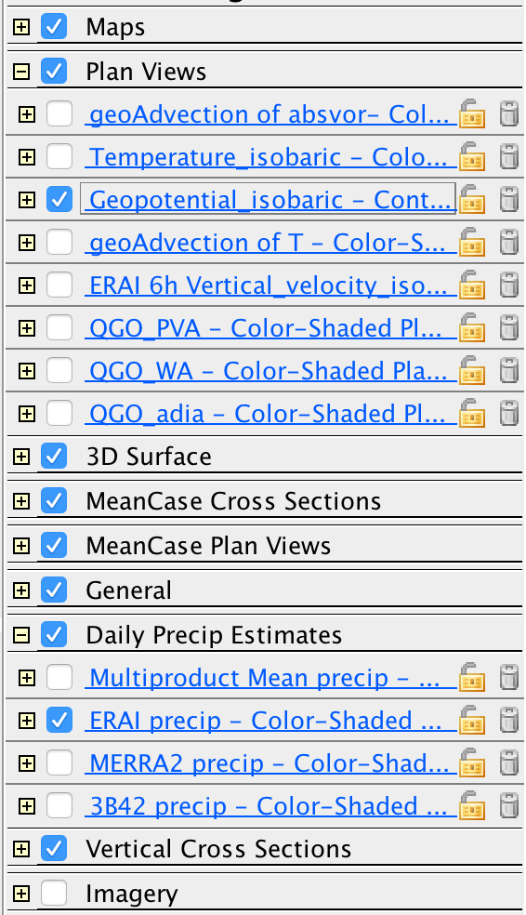
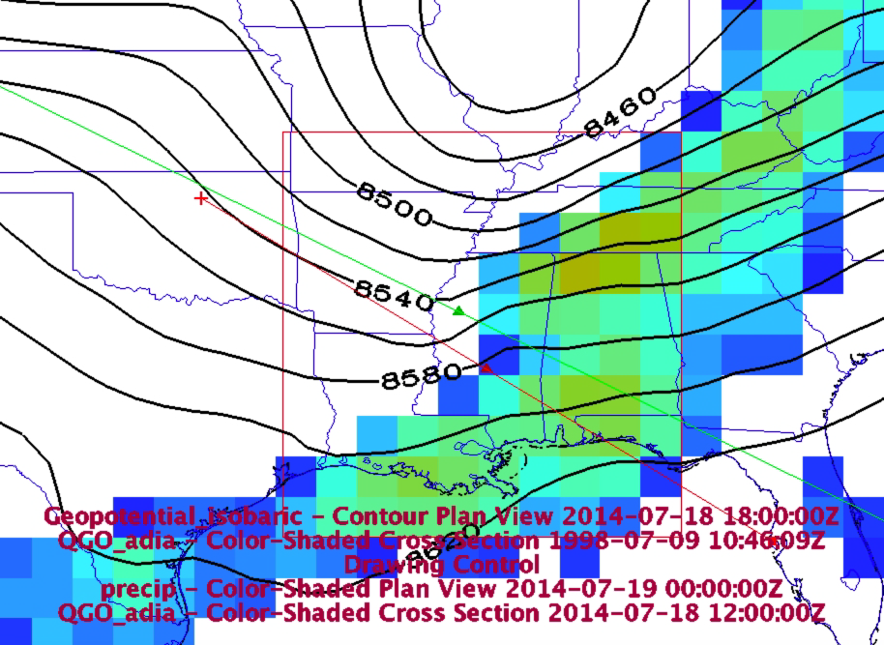
2014-07-18 Box sixed trough Basic rain, vapor, clouds, Z300

Slide 3
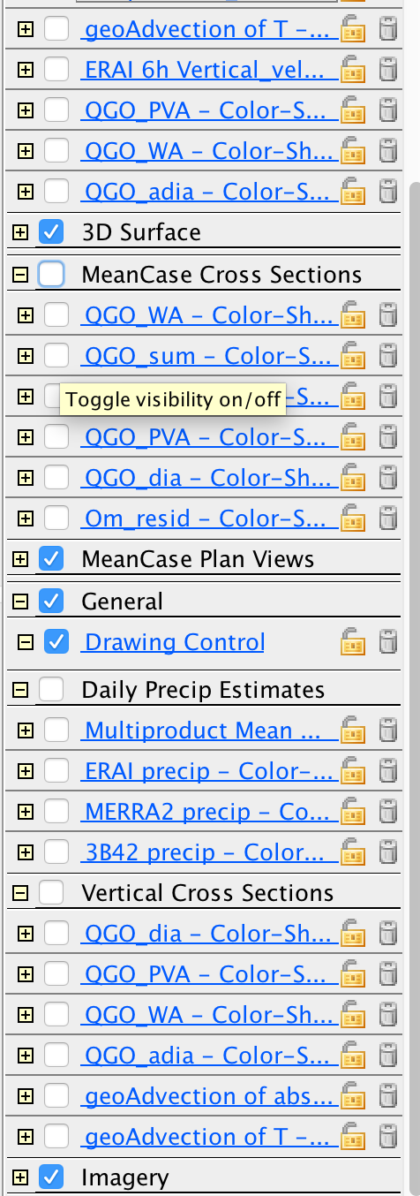
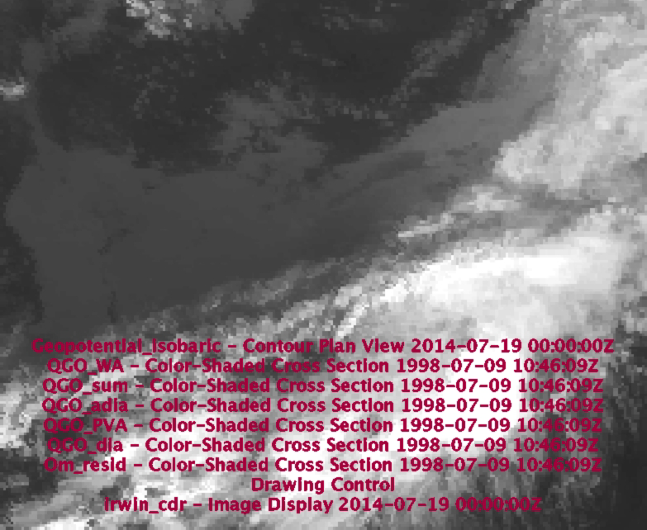
Imagery

Slide 4
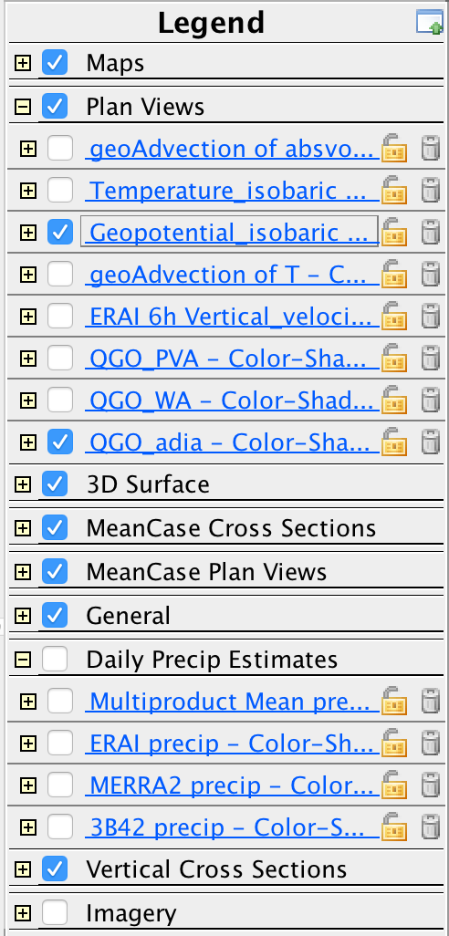
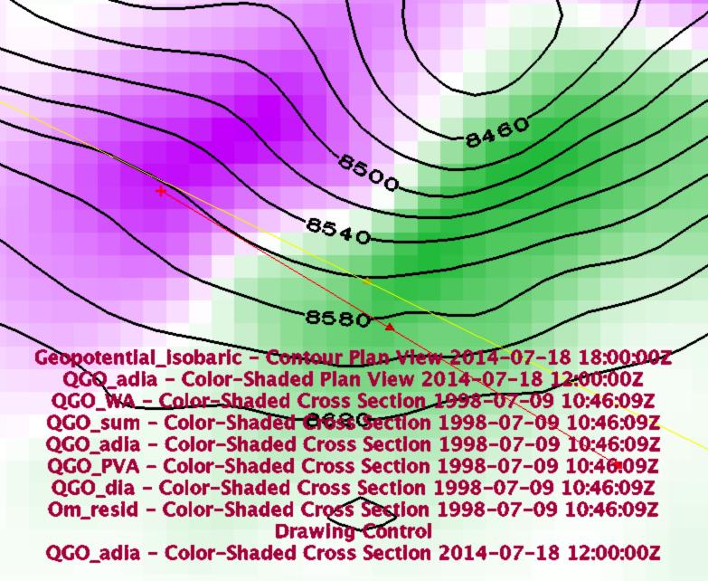
QGO_adia: Adiabatically forced ascent (where cooling is demanded by inertia, to maintain thermal wind balance)

Slide 5
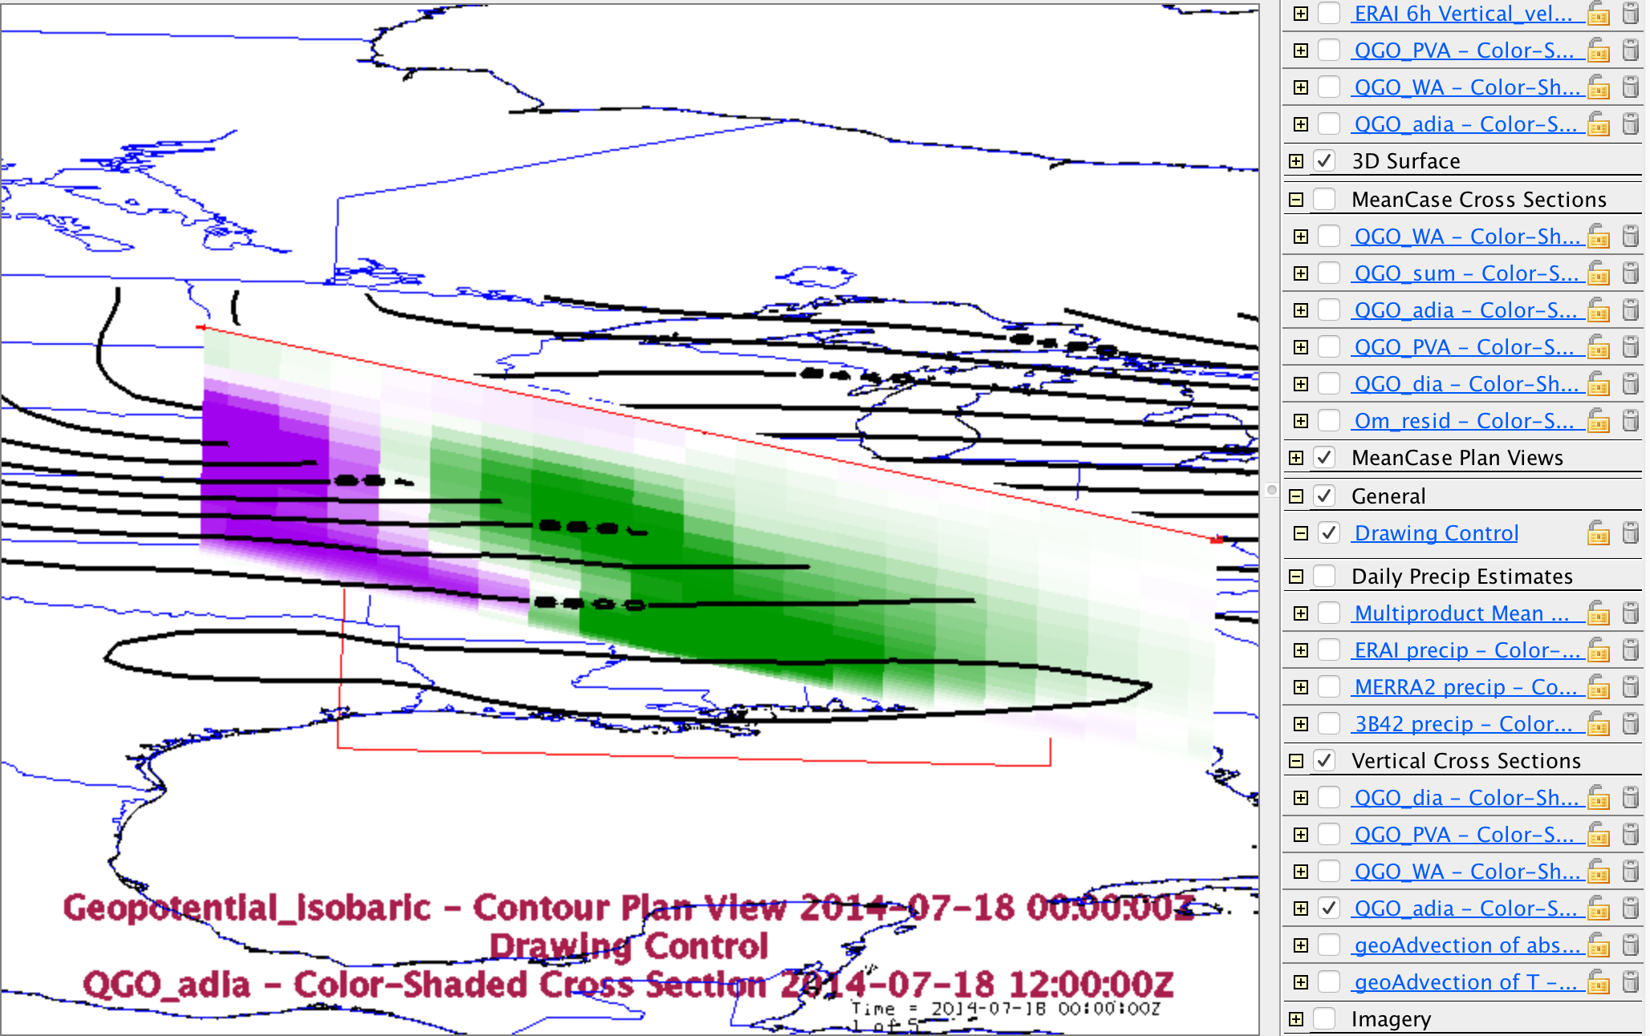
Cross Section

Slide 6
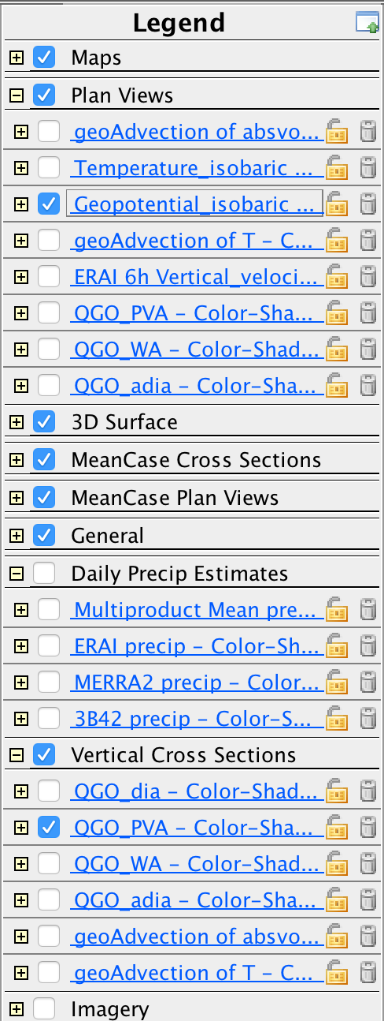
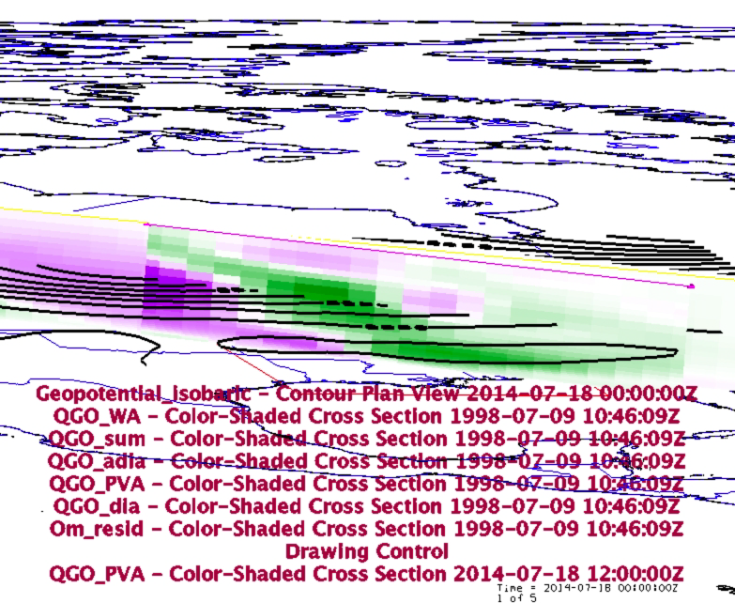
The PVA component of QGO_adia, and its forcing term ($-V.\nabla \zeta_a$, noticing that $\partial / \partial t()$ of it is the forcing)

Slide 7
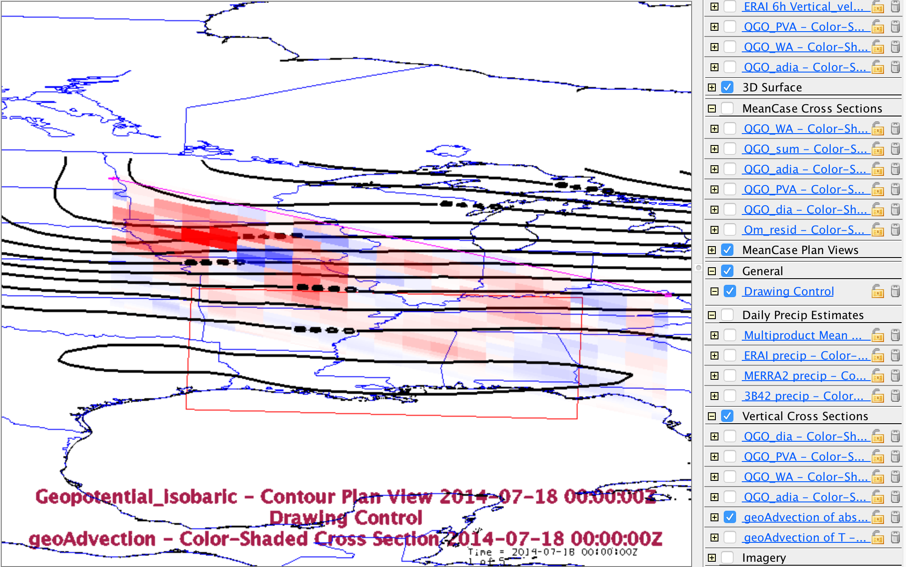
PVA

Slide 8
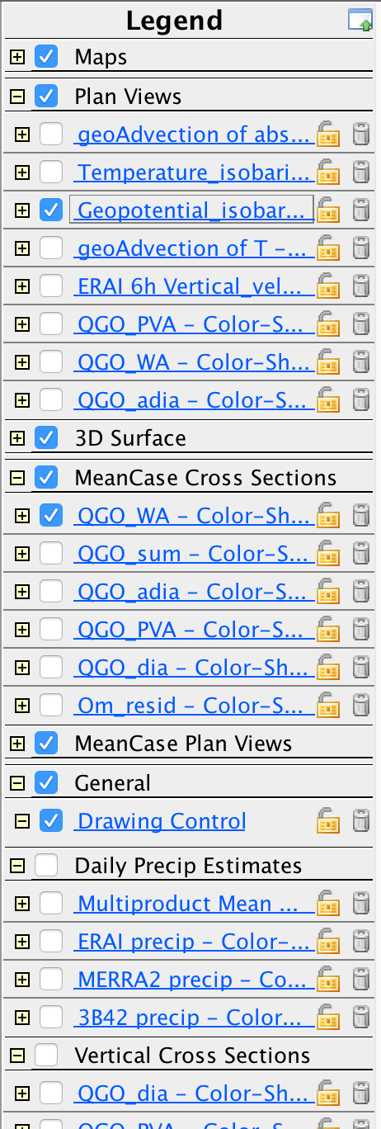
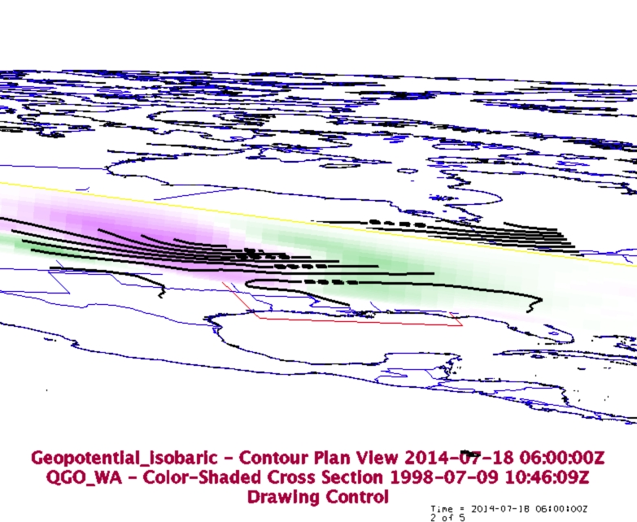
The WAA component of QGO_adia, and its forcing term ($-V.\nabla T$)

Slide 9
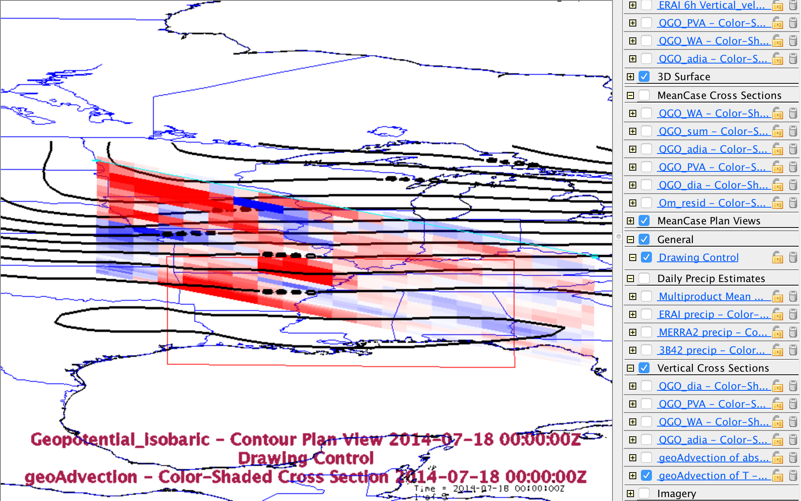

Slide 10
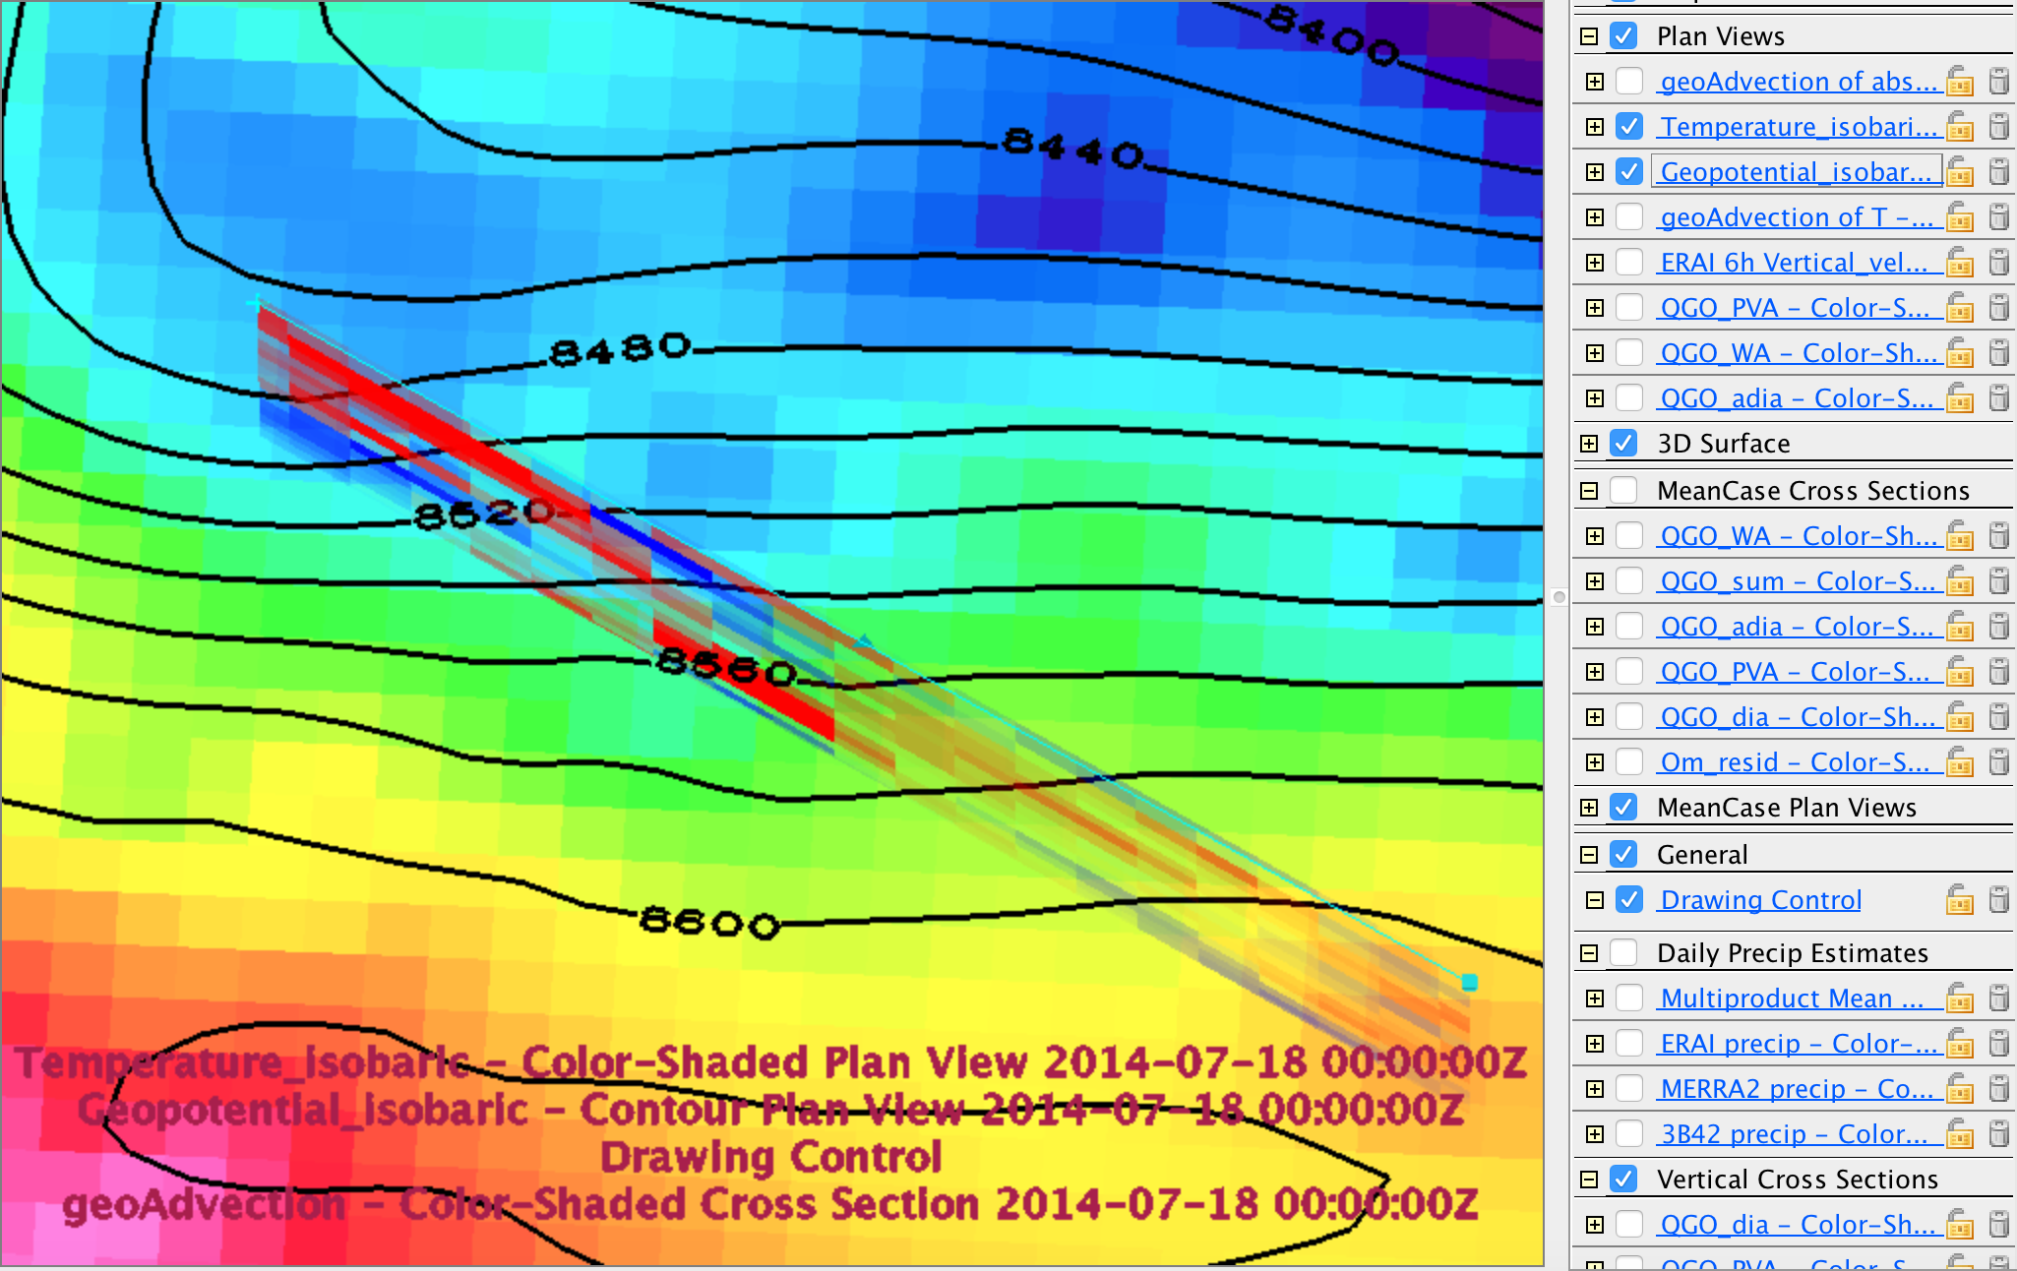

Slide 11
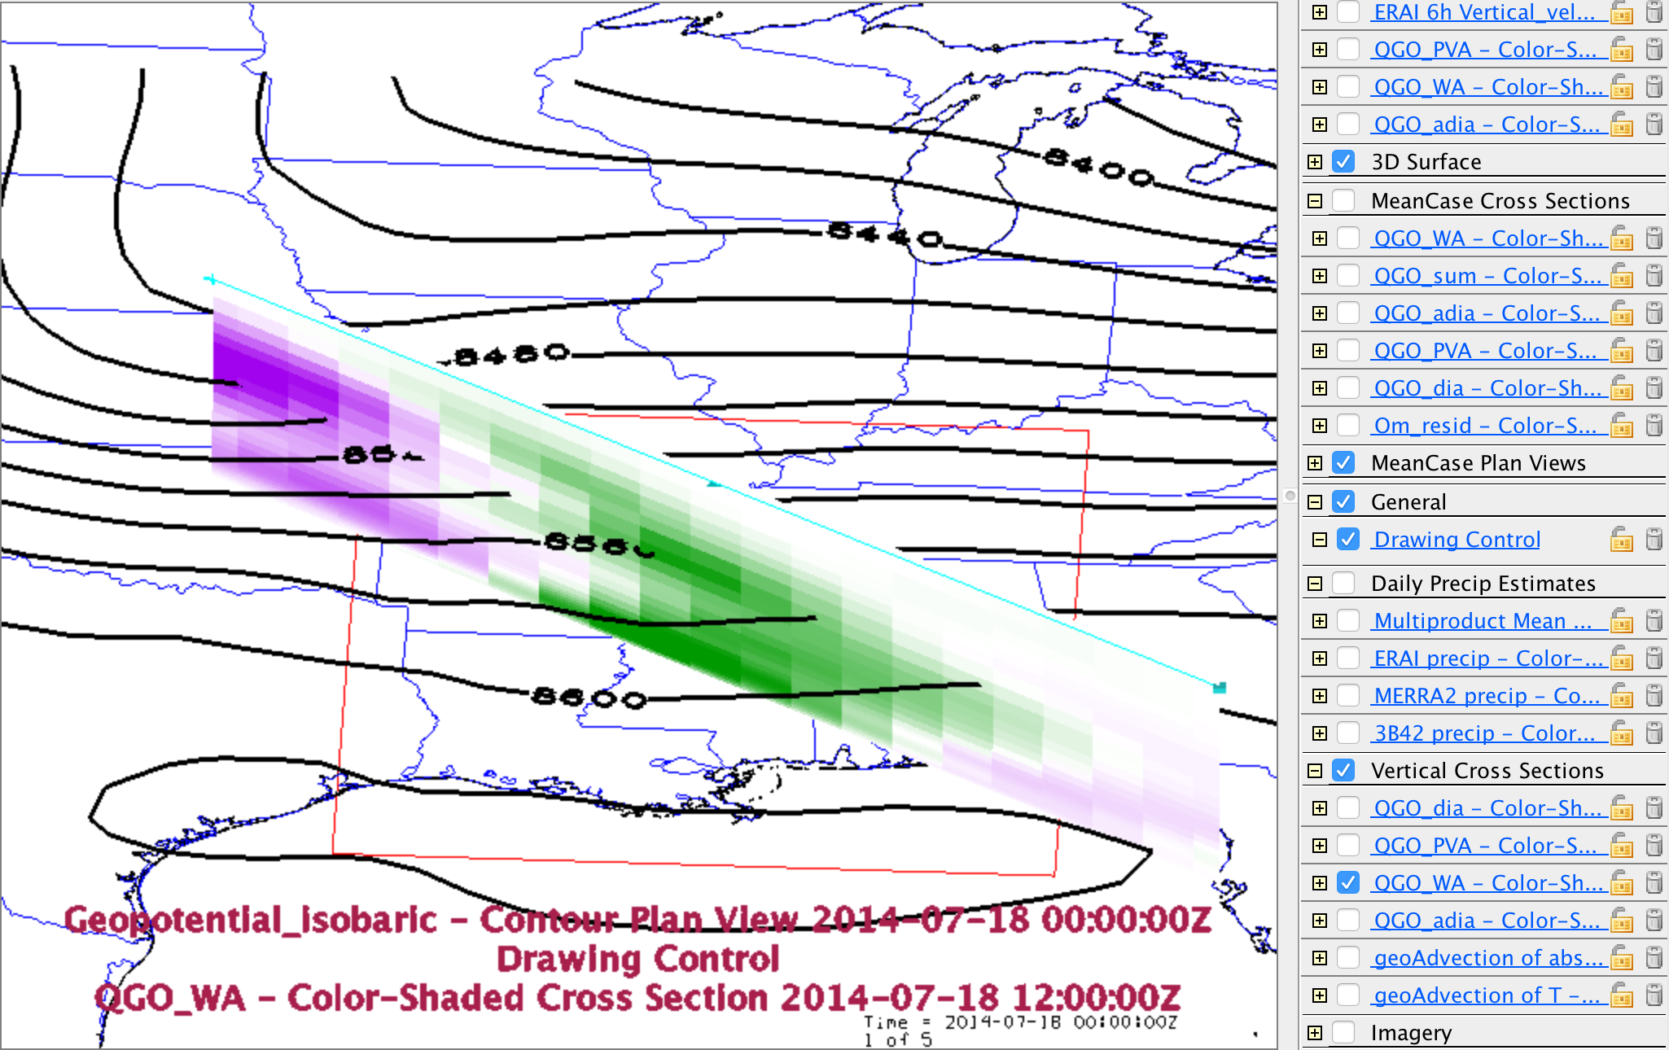

Slide 12
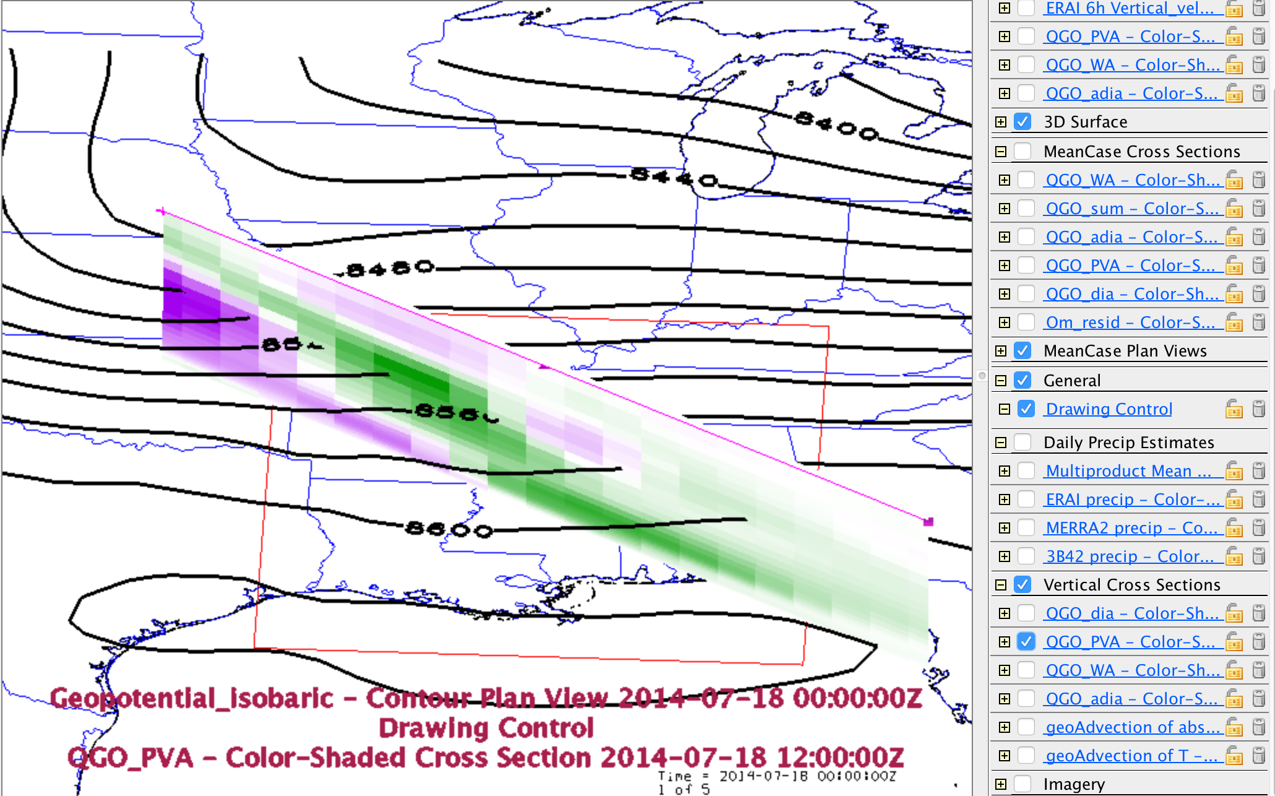

Slide 13
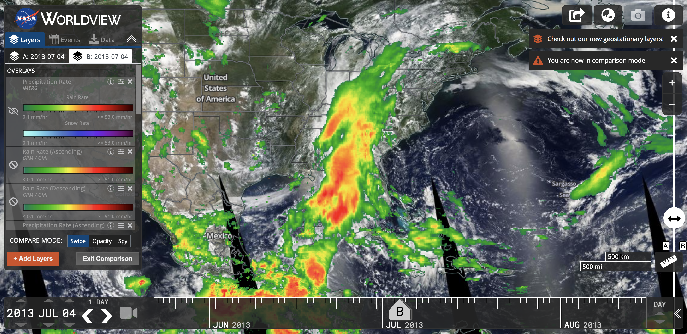
NASA WOLRD VIEW

Slide 14
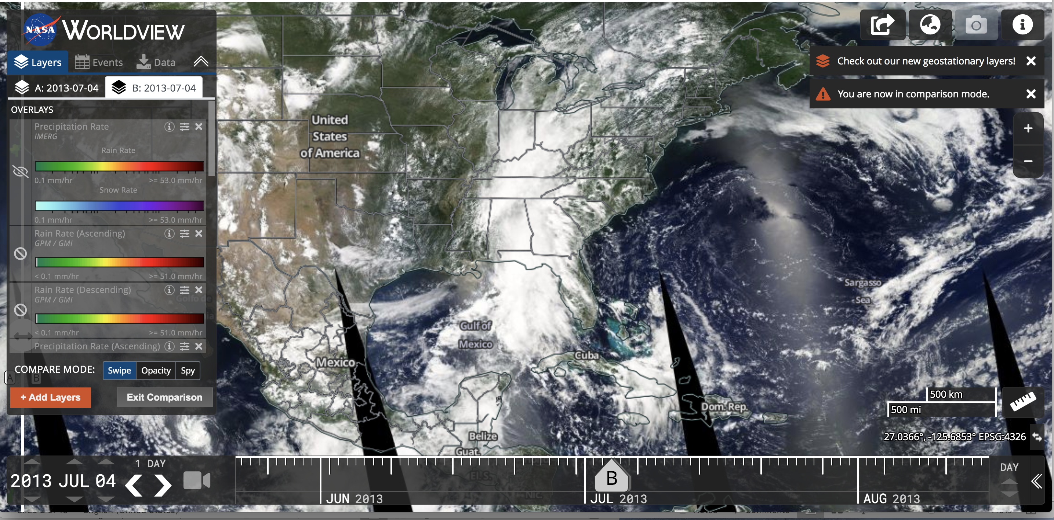
NASA WORLD VIEW

Slide 15
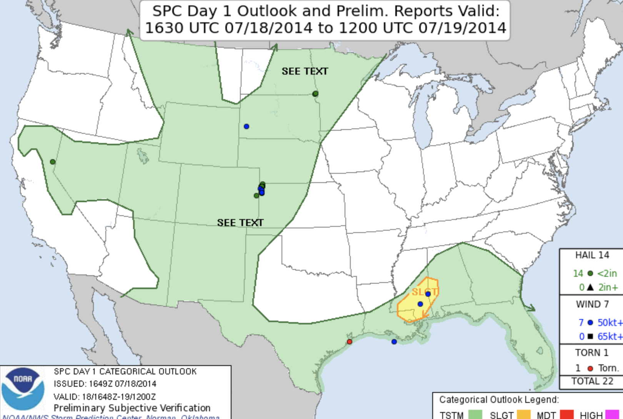
NWS- SPC→Day 1 Convective Outlook 6Z Verification:

Slide 16
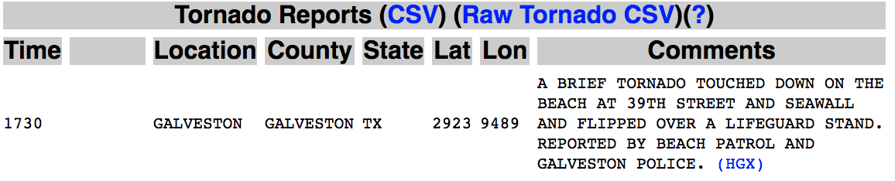
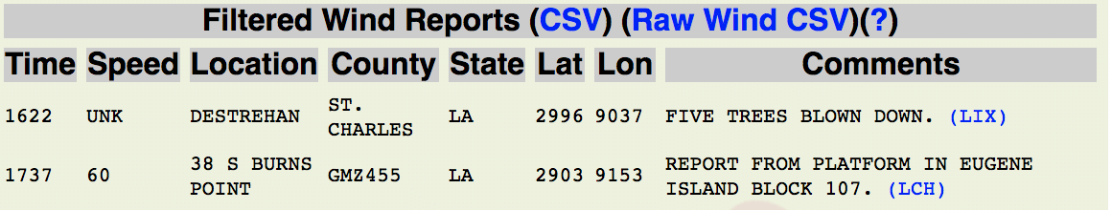
NWS-SPC

Slide 17
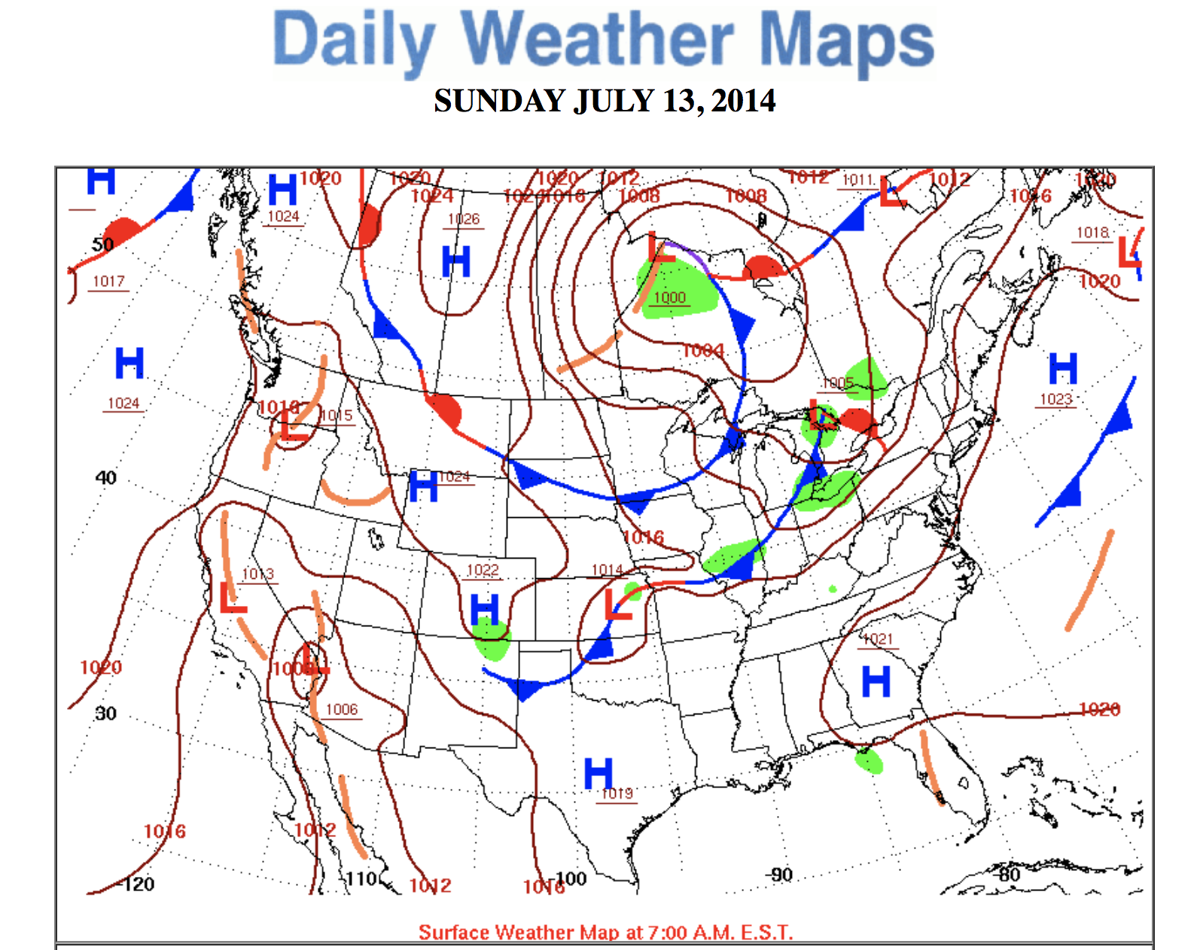
NWS-WPC → DAILY WEATHER MAPS

Slide 18
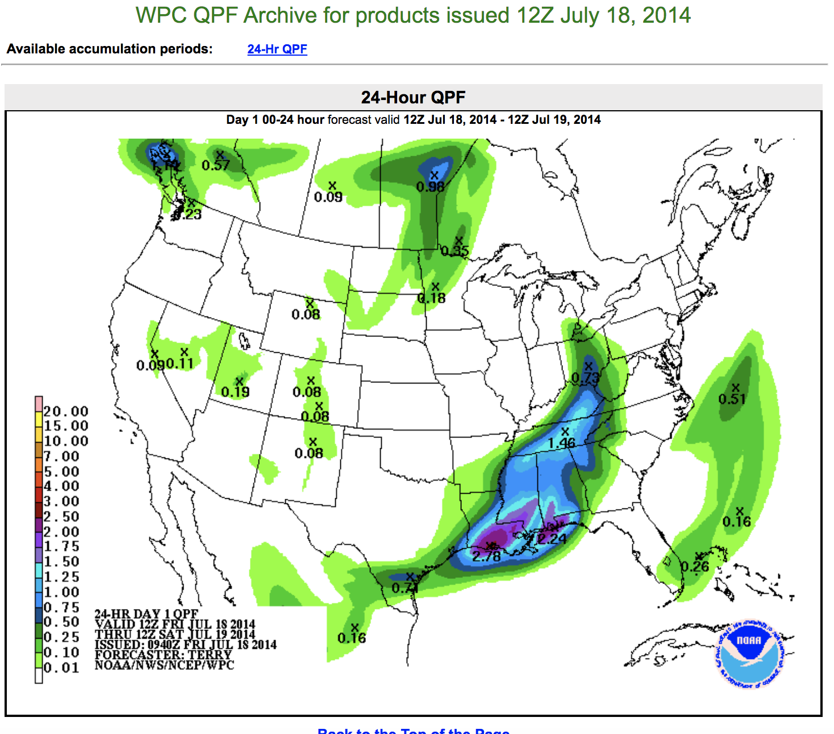
NWS-WPC → QRF ARCHIVE

Slide 19
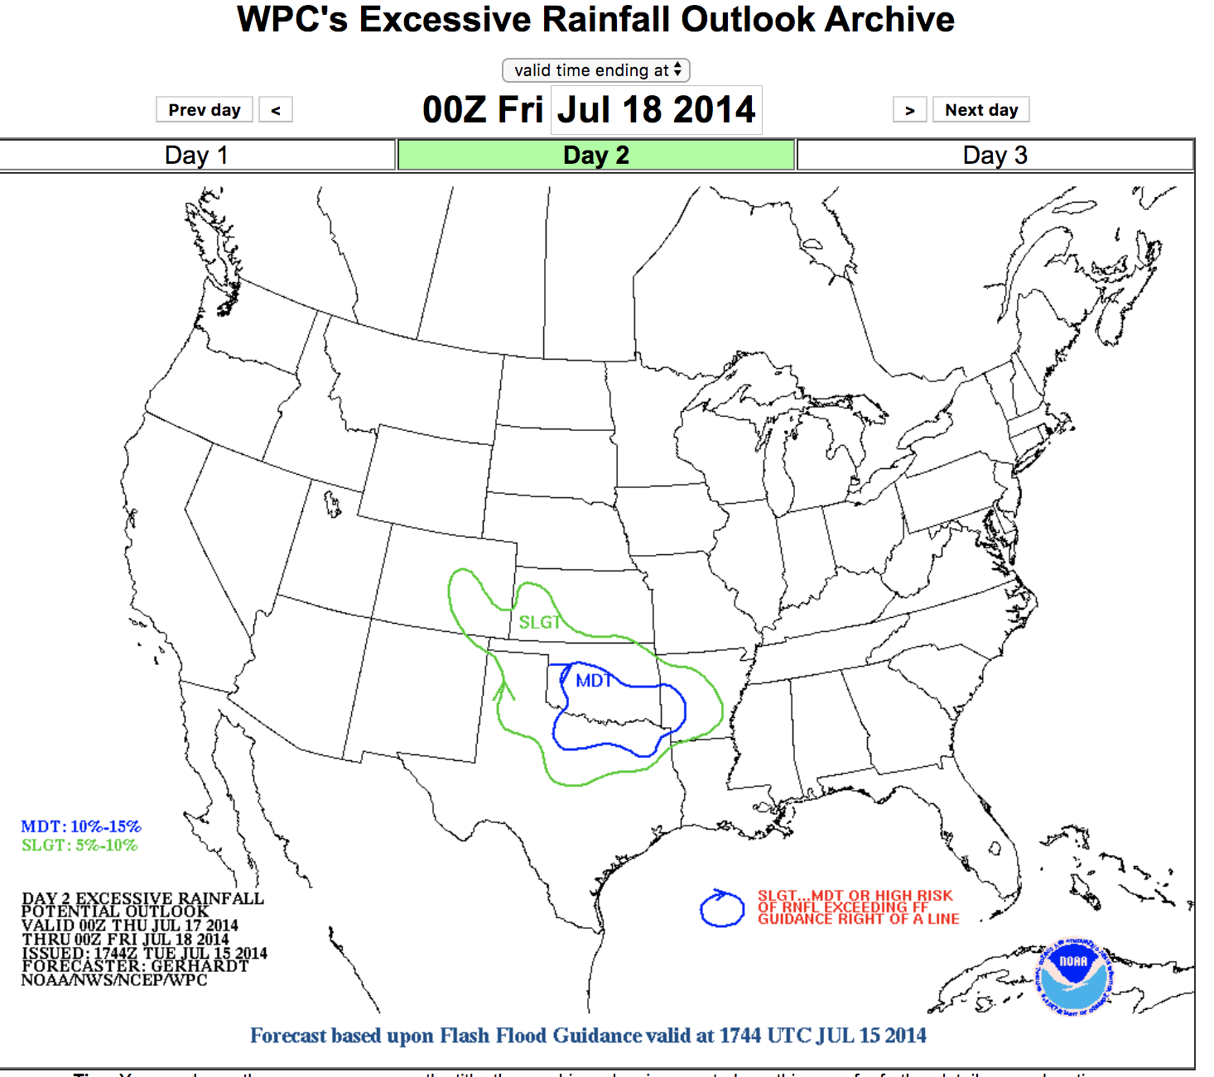
NWS-WPC → EXCESSIVE RAINFALL OUTLOOK
Outlook was not as severe as it could have been for the severe conditions that arose

Slide 20
WPC Well Reported
It was a well forecasted storm, 4 different discussions were issued on this front and its associated flash flooding and high level of precipitation.
Each 4 Discussions highlighted in the following slides:

Slide 21
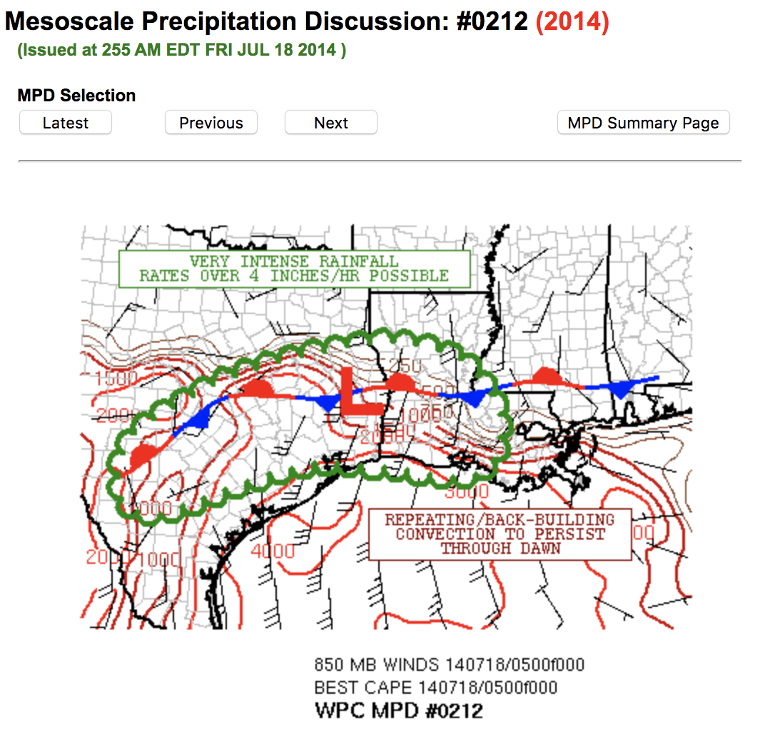
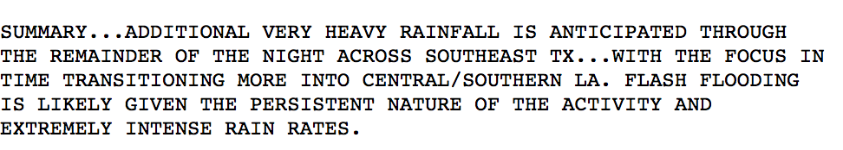
SOME AMPLIFICATION TO THE SHORTWAVE TROUGH
COLDEST CONVECTIVE TOPS PRIMARILY OVER SOUTHEAST TX
POOL OF VERY UNSTABLE AIR POOLED ALONG THE WRN GULF COAST
HIGHLY FAVORABLE THERMODYNAMIC ENERGY
CONTINUATION OF SLOW-MOVING CONVECTIVE CLUSTERS INCLUDING CELL-MERGERS AND BACK-BUILDING OF CELLS. (AKA FRONT)
A SUSTAINABLE THREAT FOR REPEATING CONVECTION. RAINFALL RATES HAVE ALREADY BEEN REPORTED TO BE OVER 4 INCHES/HR LOCALLY
https://www.wpc.ncep.noaa.gov/metwatch/metwatch_mpd_multi.php?md=0212&yr=2014

Slide 22
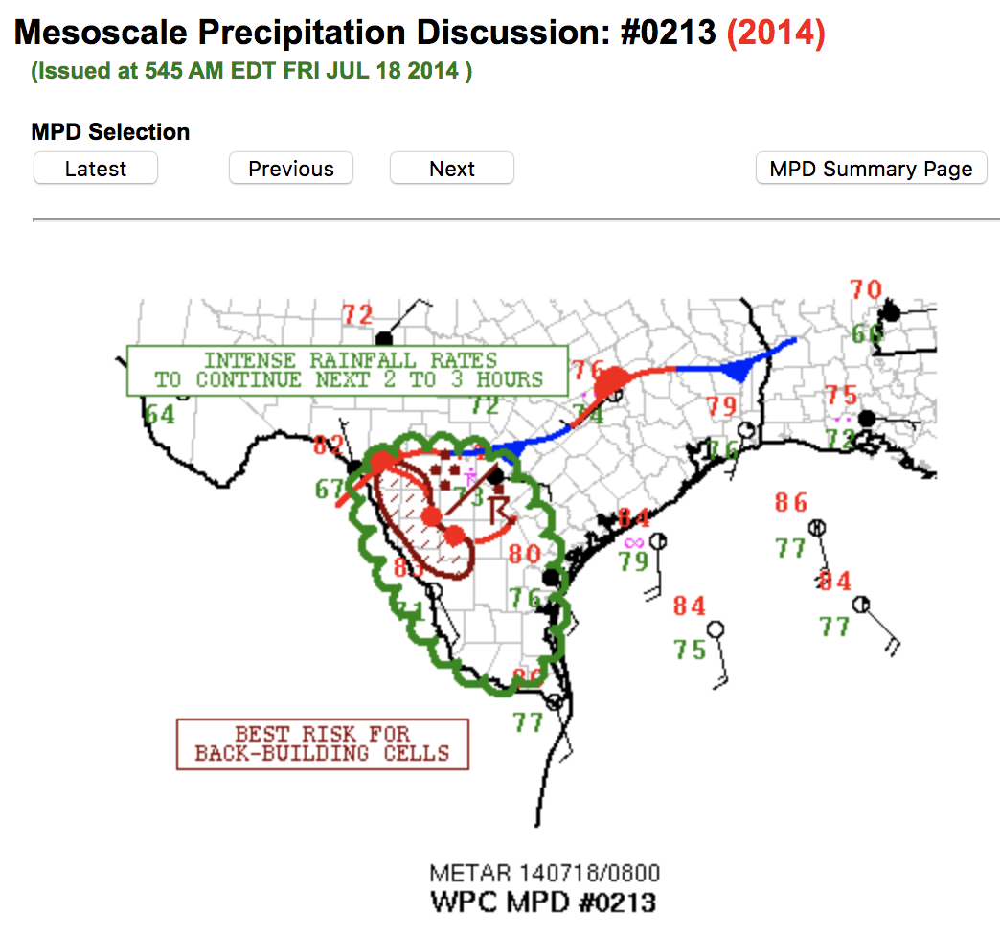
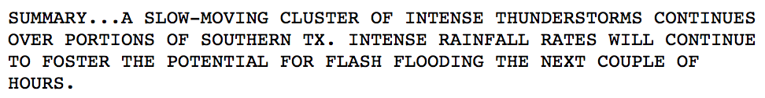
VERY COLD CLOUDS TOPS IN ASSOC WITH WHAT IS ESSENTIALLY A SLOW-MOVING MCS OVER PARTS OF SOUTHERN TX
THE CONVECTION IS FOCUSED NEAR A WELL-DEFINED FRONTAL ZONE AND IS BEING SUPPORTED BY THE TRANSPORT OF MOIST/UNSTABLE AIR
FAIRLY DIV FLOW ALOFT RIGHT NOW TOO WHICH IS YIELDING SOME LARGER SCALE ASCENT.
https://www.wpc.ncep.noaa.gov/metwatch/metwatch_mpd_multi.php?md=0213&yr=2014

Slide 23
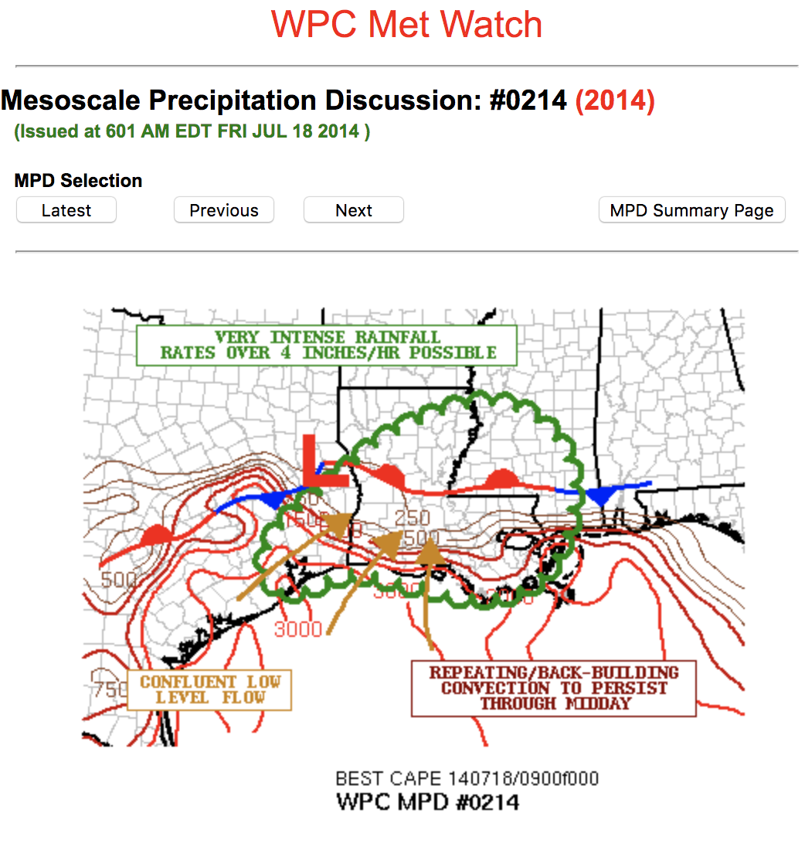
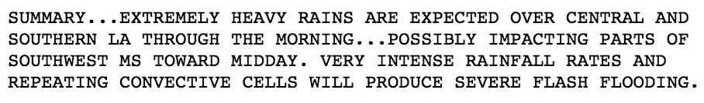
INTENSE CLUSTERS AND ORGANIZED BANDS OF CONVECTION
STRONG UPPER LEVEL TROUGH PROVIDED SOME ORGANIZED LARGER SCALE ASCENT OVER THE FRONTAL ZONE AND RESPONSIBLE FOR A WAVE OF LOW PRESSURE ALONG THE FRONT
VERY UNSTABLE AIR POOLED OUT OVER THE WRN GULF OF MEXICO
DEEPER LYR ASCENT AND IMPRESSIVE THERMODYNAMICAL ENERGY TRANSPORT LENDS SUPPORT TO THE IDEA OF EXTREMELY HEAVY RAINS
https://www.wpc.ncep.noaa.gov/metwatch/metwatch_mpd_multi.php?md=0214&yr=2014

Slide 24
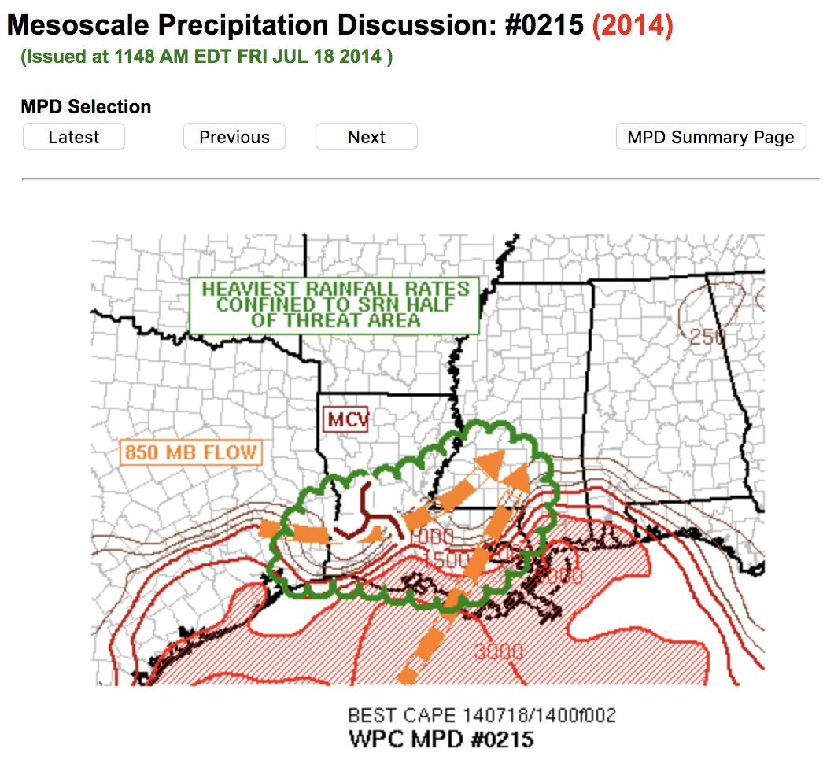
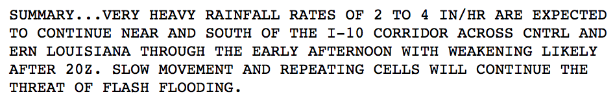
GROUND BASED GPS PRECIPITABLE WATER VALUES OF 2.25 TO 2.75 INCHES...WHICH ARE ABOVE THE 95TH PERCENTILE AND/OR NEAR THE 99TH PERCENTILE FOR JULY
CONTINUED CONFLUENT LOW LEVEL FLOW TRANSPORTING MOIST GULF AIR NWD INTO LOUISIANA.
ALONG THE SRN HALF OF THE THREAT AREA WHERE THE GREATEST INSTABILITY IS PRESENT HELPING TO SUPPORT HIGHER RAINFALL RATES.
https://www.wpc.ncep.noaa.gov/metwatch/metwatch_mpd_multi.php?md=0215&yr=2014

Slide 25
Related Journalism
http://bowienewsonline.com/2014/07/rainfall-helps-lake-amon-carter-rise/
https://wansteadmeteo.com/2014/07/

